Slide 1

IF Conditional Statement
Understanding decision-making in Linux shell scripting

Slide 2

Purpose of IF in Linux
The if statement is a fundamental control flow mechanism in shell scripting, allowing scripts to make decisions based on specified conditions.
Automate Decisions
Check Files, Users, Variables
Create Smarter Shell Scripts
Streamline tasks by enabling scripts to respond dynamically to different scenarios.
Perform checks on file existence, user permissions, and variable values to control script execution.
Build robust and adaptive scripts that can handle various inputs and environments.

Slide 3

Basic IF Syntax
The if statement evaluates a condition and executes a block of commands only if the condition is true.
if [ condition ]; then commandsfi
The condition is typically an expression that evaluates to true or false. The then keyword introduces the commands to be executed, and fi marks the end of the if block.

Slide 4

IF-ELSE Example
The if-else construct provides an alternative set of commands to execute when the initial condition is false.
if [ $USER == 'root' ]; then echo 'Root user'else echo 'Regular user'fi
This example checks if the current user is 'root'. If true, it prints "Root user"; otherwise, it prints "Regular user."

Slide 5

ELIF Example
The elif (else if) statement allows for multiple conditions to be checked sequentially. If the first if condition is false, the elif condition is evaluated.
if [ -f /etc/passwd ]; then echo 'File exists'elif [ -d /etc ]; then echo 'Directory exists'else echo 'Neither file nor directory exists'fi
This script first checks for the existence of the /etc/passwd file. If not found, it checks if /etc is a directory.

Slide 6

Real Use Cases of IF Statement
Conditional statements are indispensable for creating robust and intelligent shell scripts across various applications.
Checking Services
Verify if critical system services are running and restart them if necessary.
File Validation
Ensure files exist, have correct permissions, or meet specific size requirements before processing.
Network Checks
Confirm network connectivity to external resources or internal servers.
Automation Scripts
Implement complex decision-making logic in backup routines, deployment scripts, and more.

Slide 7

Flatpak – Package Management
A modern way to install and sandbox Linux applications.
Flatpak is a universal packaging system for Linux, designed to simplify application distribution and management. It provides a secure, sandboxed environment for applications, ensuring consistency across different Linux distributions.

Slide 8
Why Flatpak?
Flatpak addresses many challenges in Linux application deployment, offering a superior experience for both developers and users.
Secure Sandboxing
Cross-Distro Support
Easy Updates
Large App Ecosystem
Applications run in isolated environments, protecting your system from potential security vulnerabilities.
Install applications once and run them on any Linux distribution that supports Flatpak.
Stay up-to-date with the latest software releases and security patches effortlessly.
Access a vast and growing collection of applications, including many popular desktop programs.

Slide 9
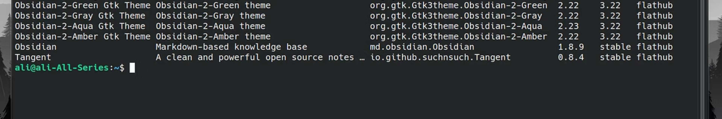
Essential Flatpak Commands
Mastering these basic commands will allow you to effectively manage Flatpak applications on your system.
# Install an applicationflatpak install flathub org.mozilla.firefox# Run an installed applicationflatpak run org.mozilla.firefox# List all installed Flatpak applicationsflatpak list
The flathub part in the install command refers to the primary Flatpak repository, though you can use other remotes as well.

Slide 10

Managing Flatpak Repositories
Flatpak repositories (remotes) are sources from which applications are installed. You can add or remove them as needed.
# Add a new Flatpak repositoryflatpak remote-add --if-not-exists my-custom-repo https://my-custom-repo.example.com/repo# Remove an existing Flatpak repositoryflatpak remote-delete my-custom-repo# List all configured Flatpak repositoriesflatpak remotes
Managing repositories is crucial for accessing specific applications or maintaining a curated set of software sources.

Slide 11

Updating & Removing Flatpak Apps
Maintaining your Flatpak applications is crucial for security and performance. This section covers essential commands for keeping your apps up-to-date and managing their removal, ensuring your system remains efficient and secure.
# Update all installed Flatpak applicationsflatpak update# Update a specific Flatpak applicationflatpak update org.mozilla.firefox# Uninstall a specific Flatpak applicationflatpak uninstall org.mozilla.firefox# Remove unused Flatpak runtimes to free up spaceflatpak uninstall --unused
Regularly updating your applications ensures you have the latest features and security fixes. Removing unused runtimes helps reclaim disk space and keeps your system tidy.

Slide 12
Real Use Cases of Flatpak
Flatpak extends its utility beyond basic application installation, offering significant advantages in various advanced scenarios.
Deploying GUI apps
Easy distribution of desktop applications across different Linux distributions
Building consistent development environments
Ensuring developers have identical toolchains and dependencies
Isolating software dependencies
Preventing conflicts between different application requirements

